Slide 1




Noida Institute of Engineering and Technology, Greater Noida
(Java Persistence API)JPA
Unit: 5
ADVANCED JAVA PROGRAMMING
(ACSE-0601)
Shweta Singh
Assistant Professor
CSE(AI)
Course Details (B.Tech 6th Sem /3rd Year)

Slide 2
Faculty Introduction
Name | Shweta Singh
Qualification | M. Tech. (CSE),Pursuing Ph.d(Engineering)
Designation | Assistant Professor
Department | Computer Science & Engineering-AI
Total Experience | 13 years
NIET Experience | 1 years
Subject Taught | Core Java and Advance Java , BDA using Excel, Artificial Intelligence, Soft Computing, C Programming, Web Technology, Discrete Mathematics,Operating System,OOPs ,C++,Computer Graphics.

Slide 3
Name of Subject with code, Course and Subject Teacher
Brief Introduction of Faculty member with Photograph
Evaluation Scheme
Subject Syllabus
Branch-wise Applications
Course Objective (Point wise)
Course Outcomes (COs)
Program Outcomes only heading (POs)
COs and POs Mapping
Program Specific Outcomes (PSOs)
Table of Contents

Slide 4
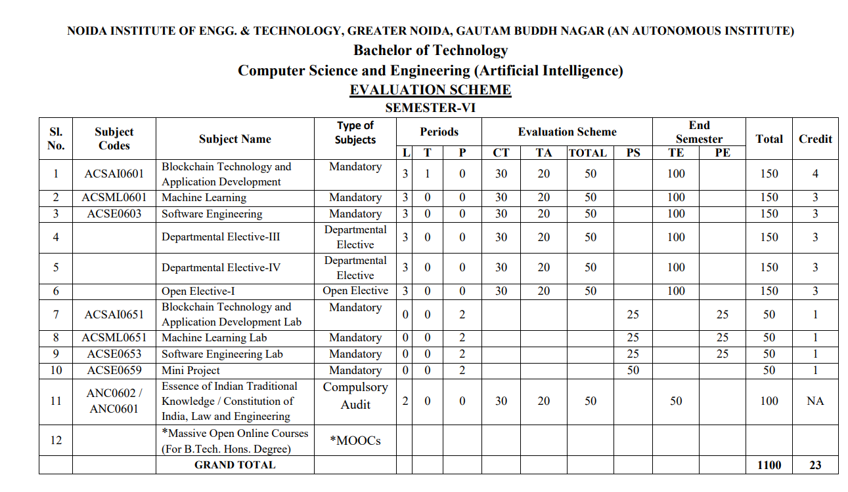

Evaluation Scheme

Slide 5
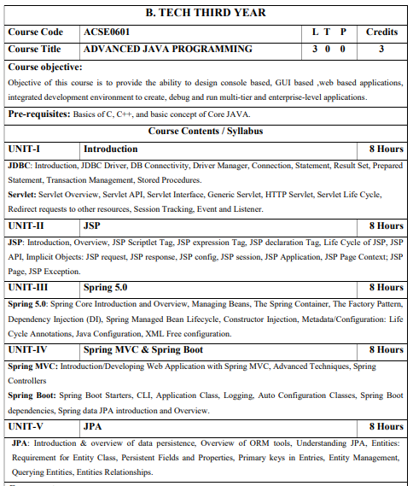
Syllabus

Slide 6
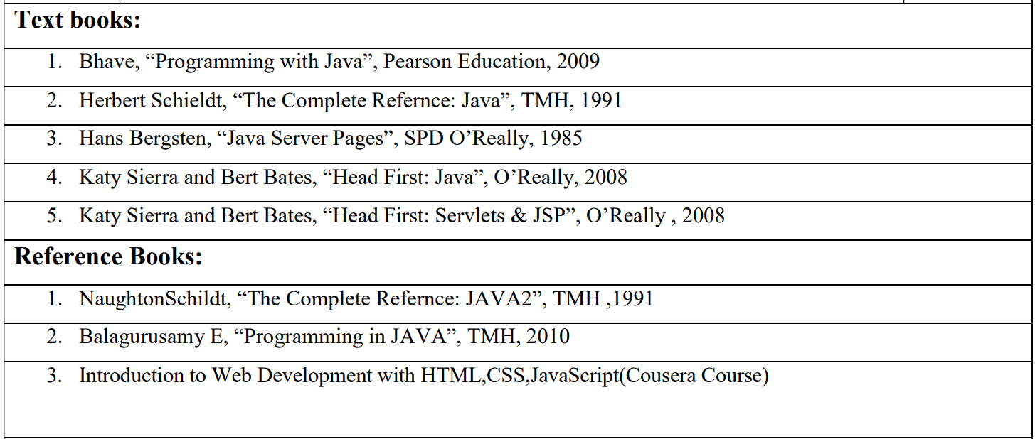
Text Books

Slide 7
Branch Wise Application
Desktop GUI Applications
Mobile Applications
Enterprise Applications
Scientific Applications
Web-based Applications
Distributed Applications
Cloud-based Applications
Web servers and Application servers
Software Tools
Gaming Applications

Slide 8
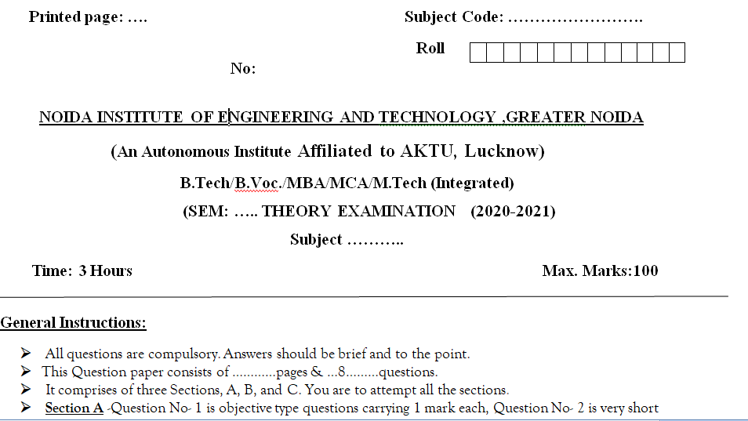
End Semester Question Paper Templates (Offline Pattern/Online Pattern)

Slide 9
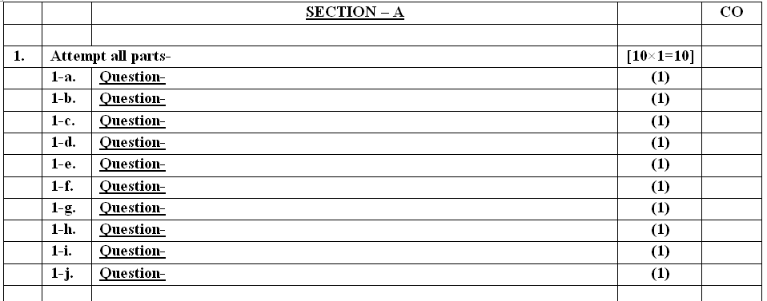
End Semester Question Paper Template

Slide 10
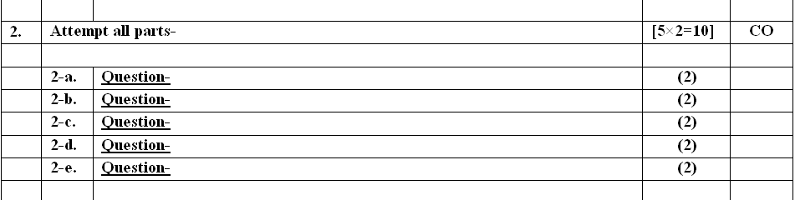
End Semester Question Paper Template

Slide 11
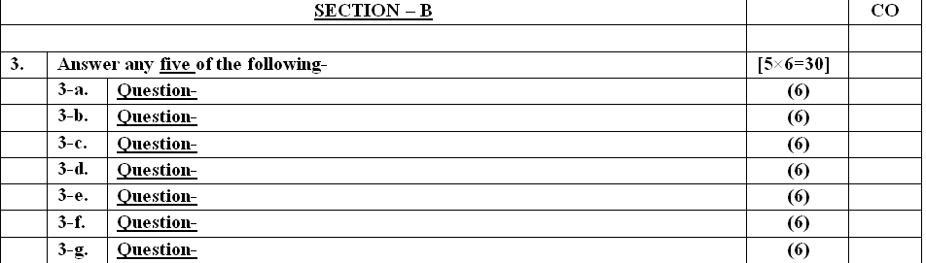
End Semester Question Paper Template

Slide 12
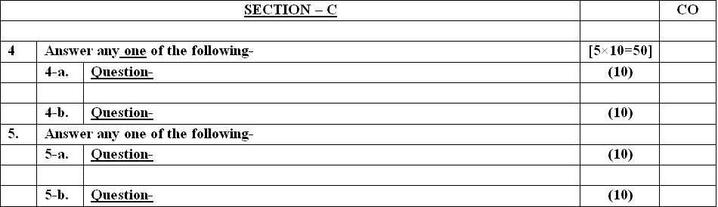
End Semester Question Paper Template

Slide 13
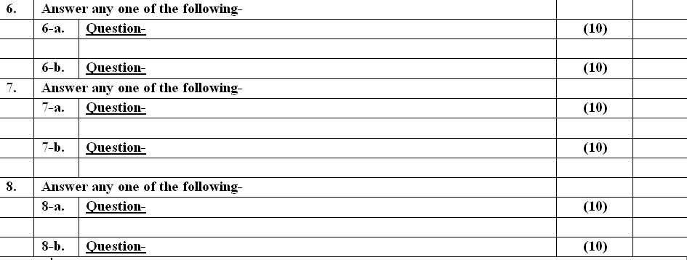
End Semester Question Paper Template

Slide 14
End Semester Question Paper Template

Slide 15
Prerequisite/Recap
Student must know at least the basics of how to use a computer, and should be able to start a command line shell.
Knowledge of basic programming concepts, as covered in ‘Programming Basic' course is necessary.
Students must have basic understanding of computer programming and related programming paradigms

Slide 16
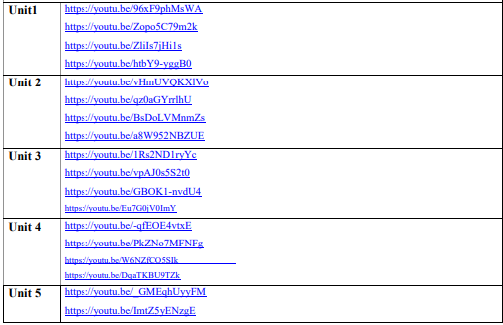
About the Subject with videos
In advanced java is to design console based, GUI based ,web based applications, integrated development environment to create, debug and run multi-tier and enterprise-level applications.

Slide 17
Topic Objectives
After you have read and studied this topic, you should be able to
To learn the JPA Concepts in Java.
To learn the concept of ORM tools.
To Understand the features entity and relation with object.

Slide 18
Topic mapping with CO
Topic | CO
overview of data persistence | CO5
Overview of ORM tools | CO5
Understanding JPA | CO5
Entities | CO5
Requirement for Entity Class | CO5
Persistent Fields and Properties | CO5
Primary keys in Entries | CO5
Entity Management | CO5
Entities Relationships. | CO5

Slide 19
Introduction & overview of data persistence
JPA is used to persist data between Java object and relational database.
JPA acts as a bridge between object-oriented domain models and relational database systems.
As JPA is just a specification, it doesn't perform any operation by itself.
It requires an implementation.
So, ORM tools like Hibernate, TopLink and iBatis implements JPA specifications for data persistence.

Slide 20
JPA Versions
The first version of Java Persistenece API,
JPA 1.0 was released in 2006 as a part of EJB 3.0 specification.
Following are the other development versions released under JPA specification:
JPA 2.0 - This version was released in the last of 2009. Following are the important features of this version: -
It supports validation.
It expands the functionality of object-relational mapping.
It shares the object of cache support.
JPA 2.1 - The JPA 2.1 was released in 2013 with the following features: -
It allows fetching of objects.
It provides support for criteria update/delete.
It generates schema.

Slide 21
JPA 2.2 - The JPA 2.2 was released as a development of maintainenece in 2017. Some of its important feature are: -
It supports Java 8 Date and Time.
It provides @Repeatable annotation that can be used when we want to apply the same annotations to a declaration or type use.
It allows JPA annotation to be used in meta-annotations.
It provides an ability to stream a query result.

Slide 22
Daily Quiz-MCQ
1. What is JPA?
a) A programming language
b) A database management system
c) A specification for ORM in Java applications
d) A scripting language
2. Which of the following is true about JPA?
a) It is specific to a particular database management system
b) It provides a way to define database schemas
c) It simplifies object-oriented programming in Java
d) It is primarily used for front-end web development

Slide 23
Daily Quiz-MCQ
4. Which annotation is used to mark a class as an entity in JPA?
a) @Entity
b) @Table
c) @Persistent
d) @EntityClass
5. What is the purpose of the @JoinColumn annotation in JPA?
a) To join multiple tables in the query
b) To specify the foreign key column in a relationship
c) To define a primary key column
d) To create an index on a column
6. Which annotation is used to define a named query in JPA?
a) @Query
b) @NamedQuery
c) @Named
d) @NamedNativeQuery

Slide 24
Daily Quiz-MCQ
MCQs - Answers and Explanations
Question 1
Answer:
c) A specification for ORM in Java applications.
Explanation:
JPA is a standard specification that defines the Java interfaces and annotations for object-relational mapping (ORM) in Java applications. It provides a unified way to interact with relational databases using object-oriented programming concepts.
Question 2
Answer:
c) It simplifies object-oriented programming in Java.
Explanation:
JPA simplifies database access by abstracting away the complexities of JDBC (Java Database Connectivity) and providing an object-oriented approach to interacting with databases.

Slide 25
Daily Quiz-MCQ
MCQs - Answers and Explanations
Question 1
Answer:
c) A specification for ORM in Java applications.
Explanation:
JPA is a standard specification that defines the Java interfaces and annotations for object-relational mapping (ORM) in Java applications. It provides a unified way to interact with relational databases using object-oriented programming concepts.
Question 2
Answer:
c) It simplifies object-oriented programming in Java.
Explanation:
JPA simplifies database access by abstracting away the complexities of JDBC (Java Database Connectivity) and providing an object-oriented approach to interacting with databases.

Slide 26
Daily Quiz-MCQ
Question 5
Answer:
b) To specify the foreign key column in a relationship.
Explanation:
The @JoinColumn annotation is used to specify the foreign key column in a relationship. It allows developers to customize the column name, nullable behavior, and other attributes of the foreign key.
Question 6
Answer:
b) @NamedQuery.
Explanation:
The @NamedQuery annotation is used to define a named query in JPA. It allows developers to pre-define queries with a specific name and reuse them throughout the application.

Slide 27
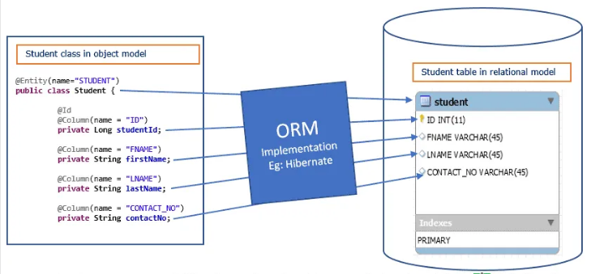
Overview of ORM tools
ORM or Object Relational Mapping is a system that implements the responsibility of mapping the Object to Relational Model. That means it is responsible to store Object Model data into Relational Model and further read the data from Relational Model into Object Model.

Slide 28
Advantage of ORM Tools
Better System Architecture
Reduce Coding Time
Caching And Transaction management

Slide 29
Popular ORM tools/frameworks in Java
Hibernate – Open Source
Top Link – By Oracle
Eclipse Link – Eclipse Persistence Platform
Open JPA – By Apache
MyBatis – Open Source – Formerly known as iBATIS
You might be interested in following articles :

Slide 30
JPA
Lecture 2
Java Persistence API(JPA)
JPA Feature
Requirement entity class

Slide 31
Understanding JPA
Lecture 2
Java Persistence API(JPA)
JPA Feature
Requirement entity class

Slide 32
Java Persistence API(JPA
JPA provides a POJO persistence model for object-relational mapping.
JPA was developed by the EJB 3.0 software expert group as part of JSR 220, but its use is not limited to EJB software components.
JPA can be used in web applications, Java SE applications directly, even its part of EJB it’s not dpends on EJB containers.
Technically JPA is just set of interfaces (Specification) and thus require an implementation.
It needs ORM(Object Relational Mapping) Java Persistence API implementation to work with and persist Java Objects.
The API defined in javax.persistence package.

Slide 33
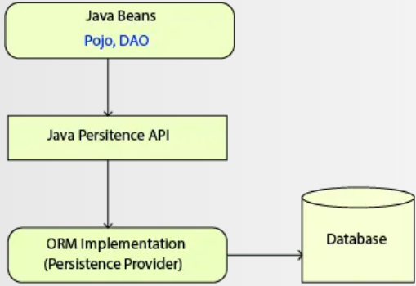
JPA Implementation

Slide 34
JPA Features

Slide 35
JPA Features
Provides cleaner, easier, standardized object-relational mapping.
JPA supports inheritance, polymorphism, and polymorphic queries.
Supports meta data annotations/xml descriptors to define the mapping between Java objects and relational database.
It supports a rich, SQL-like query language (which is a significant extension upon EJB QL) for both static and dynamic queries. Provides JPQL (Java persistence query language) and native SQL queries support.

Slide 36
JPA Features
Provides support for stored procedures since 2.1.
Pluggable persistence providers such as Hibernate, MyBatis etc.
Criteria API, which supports to build SQL queries using OOPS, so that with the JPA criteria API it’s possible to have type safe queries that can be checked at compile time.
Bean validation: the persistence provider enables Bean validation on all entities to which annotations are applied.
Caching, JPA supports 2 kinds of cache first-level cache and second-level cache to support performance tuning.
Better alignment with Java 8 features since JPA 2.2

Slide 37
Daily Quiz-MCQ
7. Which annotation is used to map an enumerated type property in JPA?
a) @Enumerated
b) @Enum
c) @EnumType
d) @Type
8. What is the purpose of the @Embedded annotation in JPA?
a) To define a relationship between entities
b) To specify a primary key column
c) To embed an object within an entity
d) To create a composite index on multiple columns
9. Which annotation is used to specify a discriminator column for entity inheritance in JPA?
a) @DiscriminatorColumn
b) @Inheritance
c) @Discriminant
d) @Discriminator

Slide 38
Daily Quiz-MCQ
10. What is the FetchType.LAZY attribute used for in JPA?
a) To fetch associated entities eagerly
b) To fetch associated entities lazily
c) To specify the join type in a query
d) To define the cascade type for an association
11. What is the purpose of JPA's PersistenceContext?
a) To manage database connections
b) To define database schemas
c) To store managed entities and their state
d) To execute database queries

Slide 39
Daily Quiz-MCQ
Question 7
Answer:
a) @Enumerated.
Explanation:
The @Enumerated annotation is used to map an enumerated type property in JPA. It allows developers to specify how the enumeration values should be persisted in the database.
Question 8
Answer:
c) To embed an object within an entity.
Explanation:
The @Embedded annotation is used to specify that an object should be embedded within an entity. It allows developers to create complex types by composing multiple attributes into a single embedded object.

Slide 40
Daily Quiz-MCQ
Question 9
Answer:
a) @DiscriminatorColumn.
Explanation:
The @DiscriminatorColumn annotation is used to specify a discriminator column for entity inheritance in JPA. It allows developers to define a column that discriminates between different types of entities in an inheritance hierarchy.
Question 10
Answer:
b) To fetch associated entities lazily.
Explanation:
The FetchType.LAZY attribute is used to specify that associated entities should be fetched lazily, i.e., only when they are accessed for the first time.

Slide 41
Daily Quiz-MCQ
Question 11
Answer:
c) To store managed entities and their state.
Explanation:
The PersistenceContext in JPA represents a cache of managed entities and their state. It is used to track changes made to entities and synchronize those changes with the database.

Slide 42
Requirement for Entity Class
JPA Entity Class
An entity is a lightweight persistence domain object.
Typically, an entity represents a table in a relational database, and each entity instance corresponds to a row in that table.
The primary programming artifact of an entity is the entity class, although entities can use helper classes.

Slide 43
The Point Entity Class Example
The following Point class, which represents points in the plane, is marked as an entity class, and accordingly, provides the ability to store Point objects in the database and retrieve Point objects from the database:
@Entity
public class Point {
// Persistent Fields:
private int x;
private int y;
// Constructor:
Point (int x, int y) {
this.x = x;
this.y = y;
}
// Accessor Methods:
public int getX() { return this.x; }
public int getY() { return this.y; }
// String Representation:
@Override
public String toString() {
return String.format("(%d, %d)", this.x, this.y);
}
}
Note: @Entity annotation, marks the class as an entity class.

Slide 44
Requirement for Entity Class
An entity class must follow these requirements.
The class must be annotated with the jakarta.persistence.Entity annotation.
The class must have a public or protected, no-argument constructor. The class may have other constructors.
The class must not be declared final. No methods or persistent instance variables must be declared final.
If an entity instance is passed by value as a detached object, such as through a session bean's remote business interface, the class must implement the Serializable interface.
Entities may extend both entity and non-entity classes, and non-entity classes may extend entity classes.
Persistent instance variables must be declared private, protected, or package-private and can be accessed directly only by the entity class's methods. Clients must access the entity's state through accessor or business methods.

Slide 45
Persistent Fields and Properties in Entity Classes
The persistent state of an entity can be accessed through either the entity's instance variables or properties.
The fields or properties must be of the following Java language types:
Java primitive types
java.lang.String
Other serializable types, including:
Wrappers of Java primitive types
java.math.BigInteger
java.math.BigDecimal
java.util.Date
java.util.Calendar
java.sql.Date
java.sql.Time
java.sql.TimeStamp
User-defined serializable types
byte[]
Byte[]
char[]
Character[]

Slide 46
Daily Quiz - MCQ
12. Which of the following annotations defines a class as an entity?
A. @table
B. @entitymanager
C. @entityfactory
D. @entity
Answer: D) @entity
Explanation:
@entity annotation is used to define a class as an entity.
13. What do you mean by ORM?
A. Object relationship mapping
B. Object-oriented relationship map
C. Originator relationship mapper
D. Object-relational mapper
Answer: D) Object-relational mapper
Explanation:
ORM stands for object-relational mapper.

Slide 47
Daily Quiz - MCQ
14. What is the relationship between EntityManager and entity?
A. One-to-one
B. Many-to-one
C. One-to-many
Answer: C) One-to-many
Explanation:
The relationship between EntityManager and entity is one-to-many.
15. What is the relationship between EntityManager and Query?
A. One-to-one
B. Many-to-one
C. One-to-many
Answer: C) One-to-many
Explanation:
The relationship between EntityManager and Query is one-to-many.

Slide 48
Daily Quiz - MCQ
16. EntityManager and EntityTransaction have a ____- relationship?
A. One-to-one
B. Many-to-one
C. One-to-many
Answer: A) One-to-one
Explanation:
EntityManager and EntityTransaction have a one-to-one relationship.
17. EntityManagerFactory and EntityManager have which kind of relationship?
A. One-to-one
B. Many-to-one
C. One-to-many
Answer: C) One-to-many
Explanation:
EntityManagerFactory and EntityManager have a one-to-many relationship.

Slide 49
Daily Quiz - MCQ
18. ____ is a factory class that generates EntityManager instances.
A. Entity
B. EntityManagerFactory
C. EntityManager
D. Persistence unit
Answer: B) EntityManagerFactory
Explanation:
EntityManagerFactory is a factory class that generates EntityManager instances.
19. The ____ serves as a logical container for a collection of entity classes.
A. Entity
B. EntityManagerFactory
C. EntityManager
D. Persistence unit
Answer: D) Persistence unit
Explanation:
The persistence unit serves as a logical container for a collection of entity classes.

Slide 50
Daily Quiz - MCQ
20. JPA is based upon which of the following architecture?
A. MVC
B. Layered architecture
C. MVVM
D. Client-server architecture
Answer: B) Layered architecture
Explanation:
JPA is based upon layered architecture.
21. JPA supports how many different inheritance strategies?
A. 5
B. 8
C. 4
D. 3
Answer: D) 3
Explanation:
JPA supports three types of inheritance strategies:SINGLE_TABLE, JOINED_TABLE, and TABLE_PER_CONCRETE_CLASS.

Slide 51
Daily Quiz - MCQ
22. Does JPA supports object-oriented concept?
A. Yes
B. No
Answer: A) Yes
Explanation:
Yes, JPA support the object-oriented concept.
23. By default, the connected entities are not retrieved alongside the primary item under the ____ strategy.
A. Eager fetch
B. Lazy fetch.
Answer: B) Lazy fetch.
Explanation:
By default, the connected entities are not retrieved alongside the primary item under the Lazy Fetch strategy.

Slide 52
Persistent Fields
By default, each field is mapped to a column with the name of the field. You can change the default name via @Column (name="newColumnName").
The following typical annotations can be used for fields/getter and setter
@Id - Identifies the unique ID of the database entry
@GeneratedValue - Together with an ID this annotation defines that this value is generated automatically.
@Transient - Field will not be saved in a database

Slide 53
Persistent Fields-Example
@Entity
@Table(name = "student")
public class Student {
@Id
@GeneratedValue(strategy = GenerationType.IDENTITY)
@Column(name = "id")
private int id;
@Column(name = "first_name")
private String firstName;
@Transient
// Field will not be saved in a database
private String lastName;
// getter and setter methods
}

Slide 54
Persistent Properties
persistent properties mean getter and setter methods.
If the entity uses persistent properties, the entity must follow the method conventions of JavaBeans components( getter and setter methods).
The object/relational mapping annotations for persistent properties must be applied to the getter methods.
Mapping annotations cannot be applied to fields or properties annotated @Transient or marked transient.

Slide 55
Persistent Properties
@Entity
@Table(name = "student")
public class Student {
private int id;
private String firstName;
@Id
@GeneratedValue(strategy = GenerationType.IDENTITY)
@Column(name = "id")
public int getId() {
return id;
}
public void setId(int id) {
this.id = id;
}
@Column(name = "first_name")
public String getFirstName() {
return firstName;
}
public void setFirstName(String firstName) {
this.firstName = firstName;
}
}

Slide 56
JPA
Lecture 3
Primary key in entity

Slide 57
Primary Keys in Entities
Every JPA entity must have a primary key. An entity may have either a simple or a composite primary key.
Simple primary keys use the jakarta.persistence.Id annotation to denote the primary key property or field.

Slide 58
Example-Primary Keys in Entities
Configuring a JPA Entity Simple Primary Key Field
@Entity
@Table(name = "student")
public class Student {
@Id
@GeneratedValue(strategy = GenerationType.IDENTITY)
@Column(name = "id")
private int id;
@Column(name = "first_name")
private String firstName;
// getter and setter methods
}

Slide 59
Rules for Primary Keys class
A primary key class must meet these requirements.
The access control modifier of the class must be public.
The properties of the primary key class must be public or protected if property-based access is used.
The class must have a public default constructor.
The class must implement the hashCode() and equals(Object other) methods.
The class must be serializable.
A composite primary key must be represented and mapped to multiple fields or properties of the entity class or must be represented and mapped as an embeddable class.
If the class is mapped to multiple fields or properties of the entity class, the names and types of the primary key fields or properties in the primary key class must match those of the entity class.

Slide 60
Entity Relationship Mapping
JPA allows us to define relationships between classes, e.g. it can be defined that a class is part of another class (containment).
Classes can have one-to-one, one-to-many, many-to-one, and many-to-many relationships with other classes.
JPA provides below annotations to perform different relationships:
@ManyToOne Relation
@OneToMany Relation
@OneToOne Relation
@ManyToMany Relation

Slide 61
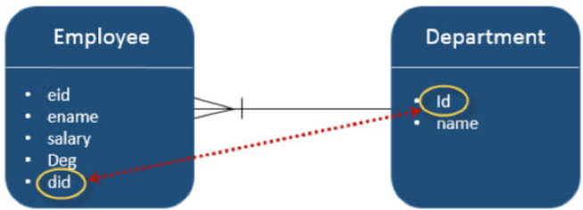
@ManyToOne Relation
Where one entity (column or set of columns) is/are referenced with another entity (column or set of columns) which contain unique values.
In relational databases these relations are applicable by using foreign key/primary key between tables.
Example: from Employee to Department, Many-To-One relation is applicable. That means each record of employee contains one department id, which should be a primary key in Department table. Here in the Employee table, Department id is foreign Key.

Slide 62
@OneToMany Relation
In this relationship each row of one entity is referenced to many child records in other entity.
The important thing is that child records cannot have multiple parents.
Let us consider the above example. If Employee and Department is in a reverse unidirectional manner, relation is Many-To-One relation. Create a JPA project in eclipse IDE named JPA_Eclipselink_OTM. All the modules of this project are shown as follows:

Slide 63
@OneToOne Relation
In One-To-One relationship, one item can belong to only one other item. It means each row of one entity is referred to one and only one row of another entity.
Let us consider the above example. Employee and Department in a reverse unidirectional manner, the relation is One-To-One relation. It means each employee belongs to only one department. Create a JPA project in eclipse IDE named JPA_Eclipselink_OTO. All the modules of this project are shown as follows:

Slide 64
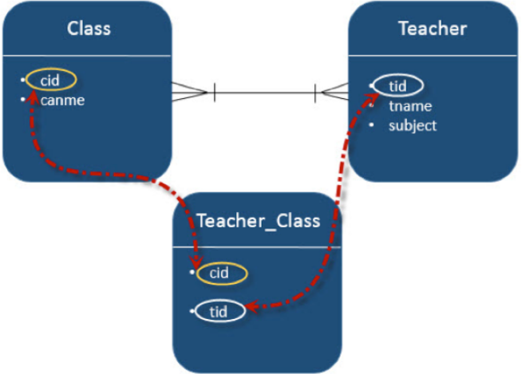
@ManyToMany Relation
Many-To-Many relationship is where one or more rows from one entity are associated with more than one row in other entity.
Let us consider an example of relation between Class and Teacher entities. In bidirectional manner, both Class and Teacher have Many-To-One relation. That means each record of Class is referred by Teacher set (teacher ids), which should be primary keys in Teacher table and stored in Teacher_Class table and vice versa. Here, Teachers_Class table contains both foreign Key fields. Create a JPA project in eclipse IDE named JPA_Eclipselink_MTM. All the modules of this project are shown as follows

Slide 65
Entity Management
Following are some of the important roles of an entity manager: -
The entity manager implements the API and encapsulates all of them within a single interface.
Entity manager is used to read, delete and write an entity.
An object referenced by an entity is managed by entity manager.
Entity Operations
Inserting an Entity
Finding an Entity
Updating an Entity
Deleting an Entity

Slide 66
Daily Quiz - MCQ
24. Which of the following is the default fetch strategy in JPA?
A. Eager fetch
B. Lazy fetch.
Answer: A) Eager fetch
Explanation:
Eager Fetch is the default fetch strategy in JPA.
25. How ways are there to fetch records from the database?
A. 2
B. 3
C. 4
D. 5
Answer: A) 2
Explanation:
There are two methods for retrieving records from a database: eager fetch and lazy fetch.

Slide 67
Daily Quiz - MCQ
26. ____ is used to create queries against entities to store in a relational database.
A. JPA API
B. Persistence Objects
C. ORM
D. JPQL
Answer: D) JPQL
Explanation:
JPQL is used to create queries against entities to store in a relational database.
27. What is JPQL?
A. Java Programming Querying Language
B. Java Programs Query Language
C. Java persistence Query Language
Answer: C) Java persistence Query Language
Explanation:
JPQL stands for Java Persistence Query Language.

Slide 68
Daily Quiz - MCQ
26. ____ is used to create queries against entities to store in a relational database.
A. JPA API
B. Persistence Objects
C. ORM
D. JPQL
Answer: D) JPQL
Explanation:
JPQL is used to create queries against entities to store in a relational database.
27. What is JPQL?
A. Java Programming Querying Language
B. Java Programs Query Language
C. Java persistence Query Language
Answer: C) Java persistence Query Language
Explanation:
JPQL stands for Java Persistence Query Language.

Slide 69
Daily Quiz-MCQ
28. The Java class encapsulates instance data and behaviors into a single unit known as an ____.
A. Object
B. Instance
C. Persistence Class
D. Java RMI
Answer: A) Object
Explanation:
The Java class encapsulates instance data and behaviors into a single unit known as an object.
29. The related entities are obtained alongside the primary item in a single query under the ____ strategy.
A. Eager Fetch
B. Lazy Fetch
Answer: A) Eager Fetch
Explanation:
The related entities are obtained alongside the primary item in a single query under the Eager Fetch strategy.
.

Slide 70
Daily Quiz - MCQ
30. Which of the following inheritance strategy maps all of an entity's subclasses to the same table in the database?
A. Table per class strategy
B. Joined table strategy
C. Single table strategy
Answer: C) Single table strategy
Explanation:
Single table Strategy maps all of an entity's subclasses to the same table in the database.
31. The ____ strategy involves creating a table for each sub entity.
A. Table per class strategy
B. Joined table strategy
C. Single table strategy
Answer: A) Table per class strategy
Explanation:
The table-per-class strategy involves creating a table for each sub-entity.

Slide 71
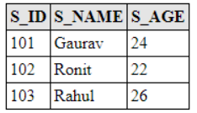
Inserting an Entity
Create an entity class named as StudentEntity.java under com.javatpoint.jpa.student package that contains attributes s_id, s_name, s_age.
After the execution of the program, the student table is generated under MySQL workbench.This table contains the student details.To fetch data, run select * from student query in MySQL.

Slide 72
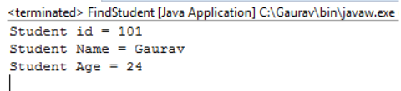
Finding an Entity
To find an entity, EntityManger interface provides find() method that searches an element on the basis of primary key.
Create an entity class named as StudentEntity.java under com.javatpoint.jpa.student package that contains attributes s_id, s_name, s_age.

Slide 73
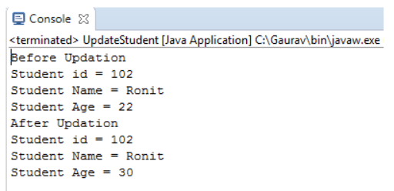
Update an Entity
Here, we will update the age of a student on the basis of primary key.
This example contains the following steps: -
Create an entity class named as StudentEntity.java under com.javatpoint.jpa.student package that contains attributes s_id, s_name and s_age.

Slide 74
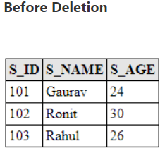
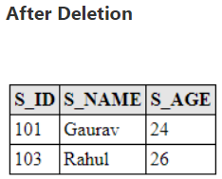
Deleting an Entity
To delete a record from database, EntityManager interface provides remove() method. The remove() method uses primary key to delete the particular record.
JPA Entity Delete Example
Create an entity class named as StudentEntity.java under com.javatpoint.jpa.student package that contains attributes s_id, s_name and s_age.
To delete a record from database, EntityManager interface provides remove() method. The remove() method uses primary key to delete the particular record.
JPA Entity Delete Example
Create an entity class named as StudentEntity.java under com.javatpoint.jpa.student package that contains attributes s_id, s_name and s_age.

Slide 75
Daily Quiz - MCQ
32. In what type of relationship is one entity connected with only one instance of another entity?
A. @ManyToOne Relation
B. @OneToMany Relation
C. @OneToOne Relation
D. @ManyToMany Relation
Answer: C) @OneToOne Relation
Explanation:
One entity is connected with one and only one instance of another entity in a one-to-one relationship.
33. Which of the following relationships links one entity with one or more instances of another entity?
A. @ManyToOne Relation
B. @OneToMany Relation
C. @OneToOne Relation
D. @ManyToMany Relation
Answer: B) @OneToMany Relation
Explanation:
One entity is connected with one or more instances of another entity in a one-to-many relationship.

Slide 76
Daily Quiz - MCQ
32. In what type of relationship is one entity connected with only one instance of another entity?
A. @ManyToOne Relation
B. @OneToMany Relation
C. @OneToOne Relation
D. @ManyToMany Relation
Answer: C) @OneToOne Relation
Explanation:
One entity is connected with one and only one instance of another entity in a one-to-one relationship.
33. Which of the following relationships links one entity with one or more instances of another entity?
A. @ManyToOne Relation
B. @OneToMany Relation
C. @OneToOne Relation
D. @ManyToMany Relation
Answer: B) @OneToMany Relation
Explanation:
One entity is connected with one or more instances of another entity in a one-to-many relationship.

Slide 77
Daily Quiz - MCQ
36. Which of the following type of cache is also known as the entity manager cache?
A. First-level cache
B. Second-level cache.
Answer: A) First-level cache
Explanation:
The first-level cache is also known as the entity manager cache.
37. Which of the following type of cache is active by default in JPA and cannot be disabled?
A. First-level cache
B. Second-level cache.
Answer: A) First-level cache
Explanation:
JPA's first-level cache is enabled by default and cannot be deactivated.

Slide 78
Daily Quiz - MCQ
38. A superclass is defined as an object without a matching database table in ____ Inheritance, and its attributes and mappings are inherited by its subclasses.
A. Table per class strategy
B. Joined table strategy
C. Single table strategy
Mapped Superclass
Answer: D) Mapped Superclass
Explanation:
A superclass is defined as an object without a matching database table in Mapped Superclass Inheritance, and its attributes and mappings are inherited by its subclasses.

Slide 79
JPA
Lecture 4
Querying Entity

Slide 80
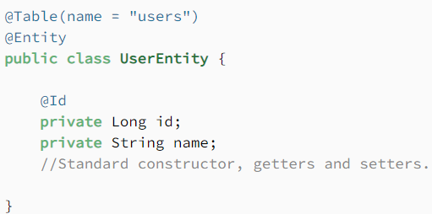
Querying Entities
There are three basic types of JPA Queries:
Query, written in Java Persistence Query Language (JPQL) syntax
NativeQuery, written in plain SQL syntax
Criteria API Query, constructed programmatically via different methods
Query: First define the UserEntity class

Slide 81
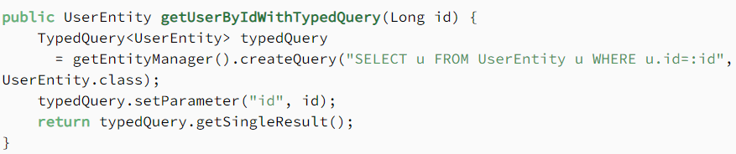
TypedQuery
JPA provides a special Query sub-type known as a TypedQuery. This is always preferred if we know our Query result type beforehand. Additionally, it makes our code much more reliable and easier to test.
This way, we get stronger typing for free, avoiding possible casting exceptions down the road

Slide 82
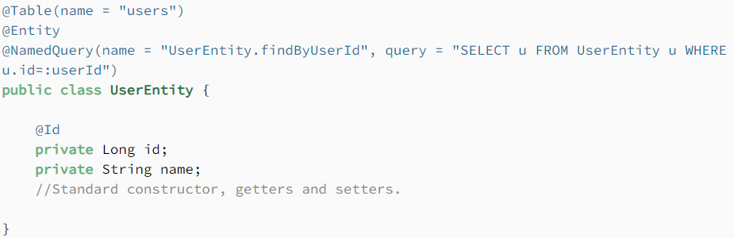
NamedQuery
While we can dynamically define a Query on specific methods, they can eventually grow into a hard-to-maintain codebase. JPA's also got us covered on this with another Query sub-type known as a NamedQuery.

Slide 83
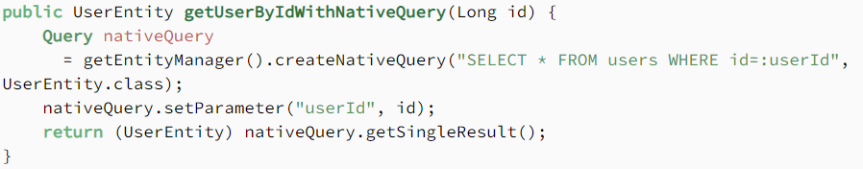
NativeQuery
A NativeQuery is simply an SQL query. These allow us to unleash the full power of our database, as we can use proprietary features not available in JPQL-restricted syntax.
This comes at a cost. We lose the database portability of our application with NativeQuery because our JPA provider can't abstract specific details from the database implementation or vendor anymore.

Slide 84
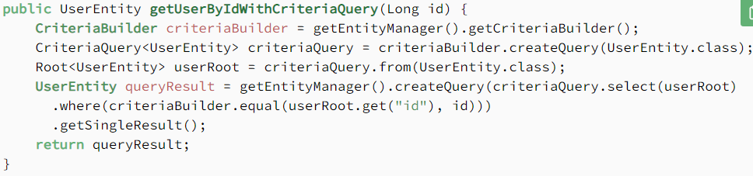
Criteria API Query
Criteria API Query are programmatically-built, type-safe queries – somewhat similar to JPQL queries in syntax:

Slide 85
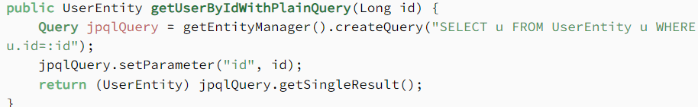
Query
A Query is similar in syntax to SQL
This Query retrieves the matching record from the users table and also maps it to the UserEntity object.
There are two additional Query sub-types:
TypedQuery
NamedQuery

Slide 86
Daily Quiz
1. Annotation for Hibernate exceptions to be translated into Spring’s DataAccessException for consistent exception handling?
A. Translation B. Repowrong
C. Repository
D. None of the mentioned
2. Which is not belongs to the JPA @Entity association attributes?
A. Association validation B. Association multiplicity C. Association cascade behaviorwrong
D. Association direction
3.An alternative to Spring’s HibernateTemplate is
A. HibernateContext
B. Hibernate’s contextual sessions
C. All of the mentionedwrong
D. None of the mentioned

Slide 87
Daily Quiz
4. Annotation for Hibernate exceptions to be translated into Spring’s DataAccessException for consistent exception handling?
A. Translation B. Repo
C. Repository
D. None of the mentioned
5. Annotation to find a transaction and then fail, complaining that no Hibernate session’s been bound to the thread.
A. Transaction
B. Transactional
C. Transactions
D. None of the mentioned
6. Which of the following Is-A mapping, requires discriminator column?
A. Single Table Mapping B. Joined Table Mapping
C. Table Per Class Mapping
D. None

Slide 88
Daily Quiz
7. JPA implementation is provided by ---?
A. Hibernate
B. Toplink
C. Ibatis
D. All of them
8.________ has stated that ideas came from several frameworks, including Hibernate and JDO.
A. Sun Microsystems
B. Java (software platform)
C. Open JDK
D. Java (programming language)

Slide 89
Daily Quiz
9. What is the Life Cycle Of A Jpa Entity?
A. New / Transient
B. Managed / Persisted
C. Detached
D. All of the above
10. Which attribute of @OneToMany is used to mark an entity as owned?
A. cascade
B. mappedBy
C. property Ref
D. None

Slide 90
Weekly Assignment
Q1. What is the Java Persistence API?[CO5]
Q2. What is the object-relational mapping?[CO5]
Q3. What are the advantages of JPA?[CO5]
Q4. What are the steps to insert an entity?[CO5]
Q5. What are the steps to find an entity?[CO5]
Q6. What are the different types of entity mapping?[CO5]
Q7. What is the role of Entity Manager in JPA?[CO5]
Q8. What are the constraints on an entity class?[CO5]
Q9. What is JPQL?[CO5]
Q10. What is the Criteria API?[CO5]

Slide 91
Topic Links
https://www.youtube.com/watch?v=r59xYe3Vyks&list=PLS1QulWo1RIbfTjQvTdj8Y6yyq4R7g-Al
https://www.digimat.in/nptel/courses/video/106105191/L01.html

Slide 92
MCQs
Q1. Which annotation is used to create the Pk-Fk relation b/w two tables?
A. JoinColumn
B. ForeignKey
C. JoinedKey
D. None of these
Q2. Object/relational metadata can be specified directly in the entity class file by using annotations, or in a separate ________ descriptor file distributed with the application.
A. Scalable Vector Graphics
B. HTML
C. XML
D. XHTML

Slide 93
MCQs
Q3. What is TRUE about the cascading and cascade mode attributes in Entity Beans?
A. Cascade mode attributes can be specified for the association annotaions (like @OneToMany) in an entity bean
B. The cascading direction is from the target entity to the source entity
C. PERSIST, DELETE and REFRESH are cascading mode attributes
D. Refresh cascade causes to refresh the target entities of a relationship when refresh is invoked on the source entity of the relationship
Q4. Which attribute of @OneToMany is used to mark an entity as owned?
A. cascade
B. mappedBy
C. property Ref
D. Nonewrong
Q5.. What is the JPA equivalent of hibernate.cfg.xml file?
A. configuration.xml
B. persistence.xml
C. jpa.configuration.xml
D. None

Slide 94
MCQs
Q6.What are the JPA @Entity association attributes?
A. Association validation
B. Association multiplicity
C. Association cascade behavior
D. Association direction
Q7.Annotation used for entity manager injection in EJB components.
A. PersistenceContext
B. Persistence
C. PersistenceCon
D. None of the mentioned

Slide 95
MCQs
Q7.Annotation used for entity manager injection in EJB components.
A. PersistenceContext
B. Persistence
C. PersistenceCon
D. None of the mentioned

Slide 96
Weekly assignment - 1
Explain the need for the Java Persistence API.
Does JPA perform tasks like access, persist, and manage data?
Design and Explain the object-relational mapping.
List out the advantages of JPA.
Why are embeddable classes needed in Advanced Java?

Slide 97
Weekly assignment - 2
List some ORM frameworks.
What is the JPQL?
What are the steps to persist an entity object?
What are the steps to insert an entity?
What are the steps to find an entity?

Slide 98
Weekly assignment - 3
Describe the steps to update an entity.
Describe the steps to delete an entity.
Insert a record mechanism using JPA.
Explain the different directions of entity mapping.
Explain the use of different types of entity mapping.

Slide 99
Weekly assignment - 4
Define an orphan removal in mappings.
Explain the persistent life cycle of an object.
Discuss the different types of identifier generation.
Implement and discuss an entity.
Explain various properties of an entity and how it is implemented.

Slide 100
Weekly assignment - 5
Discuss the role of Entity Manager in JPA.
Define the implementation of the constraints on an entity class.
Discuss the purpose of Java collections in JPA.
Explain the type of objects that can be stored in the JPA collections mapping.
What type of collections can be used in JPA?

Slide 101
Expected Questions for University Exam
Q1. What is the Java Persistence API?[CO5]
Q2. What are the steps to insert an entity?[CO5]
Q3. What is the role of Entity Manager in JPA?[CO5]
Q4. What are the constraints on an entity class?[CO5]
Q5. What are the two types of elements in Entity classes. Or in other words, list two types of access (access) to the elements of the Entity classes. [CO5]
Q6. What is the attribute of the Entity class in JPA terminology? [CO5]
What data types are allowed in the attributes of the Entity class (fields or properties)? [CO5]
Q7. What is the Embeddable class? [CO5]
Q8. Can the Embeddable class contain another Embeddable class? [CO5]

Slide 102
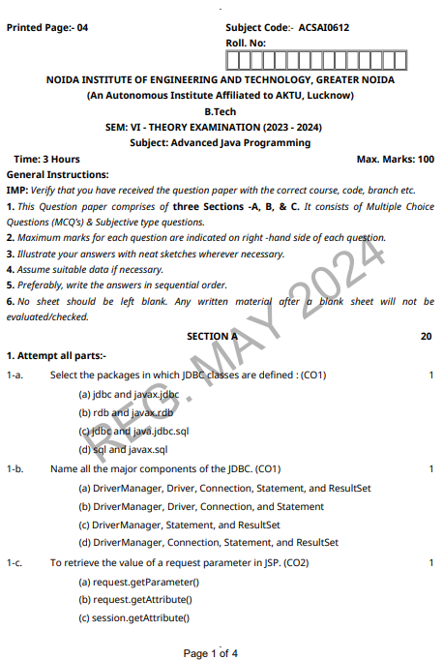
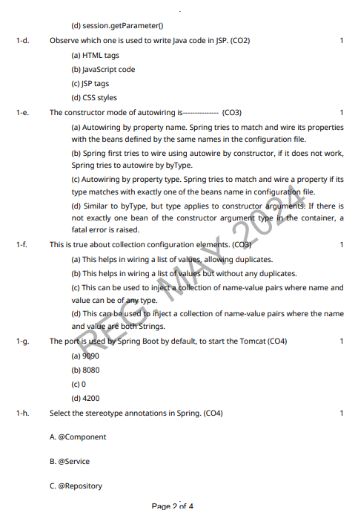
Old Question Papers

Slide 103
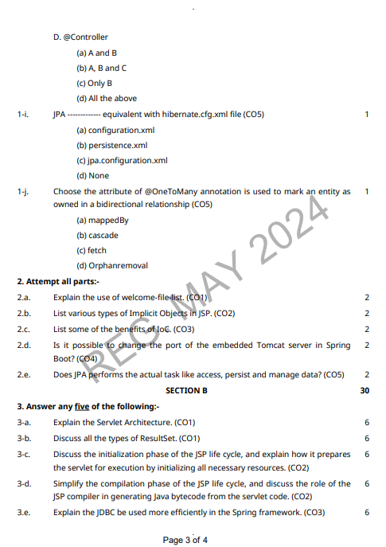
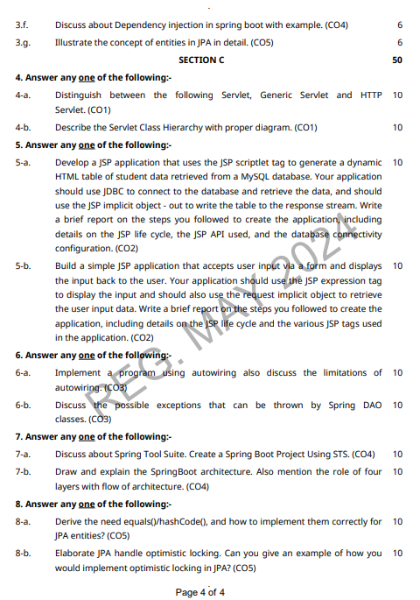
Old Question Papers

Slide 104
Recap of Unit
Unit start with examines how Object-Relational Mapping (ORM) frameworks and technologies simplify database development.
The course concludes key JPA concepts, like an EntityManager, how to create advanced queries using Java Persistence Query Language (JPQL), and examining how to structure complex entity relationships.

Slide 105
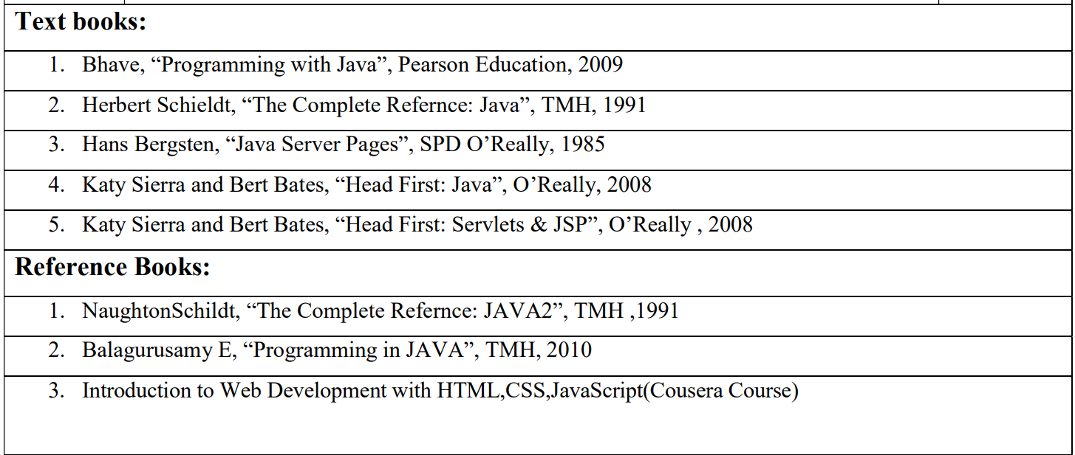
References

Slide 106
Thanks

